Slide 1
Pythagoras’ Theorem Working out the hypotenuse
Notes:
Possible resources
http://www.scootle.edu.au/ec/viewing/L6559/index.html

Slide 2
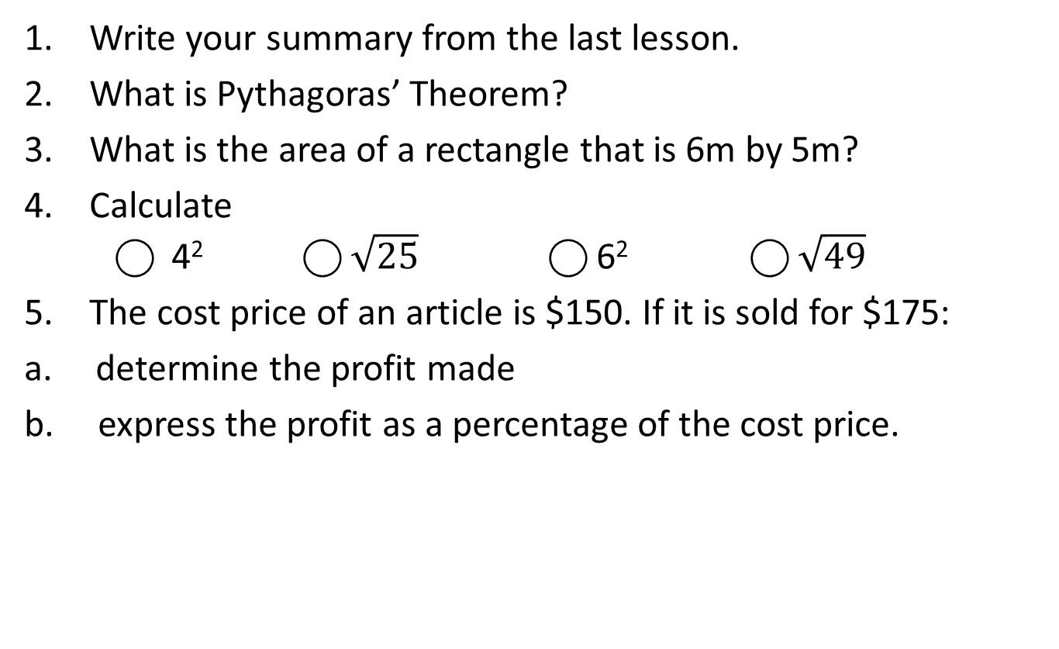
Warm Up (LHS)
Write your summary from the last lesson.
What is Pythagoras’ Theorem?
What is the area of a rectangle that is 6m by 5m?
Calculate ⃝ 4² ⃝ $\sqrt{25}$ ⃝ 6² ⃝ $\sqrt{49}$
The cost price of an article is $150. If it is sold for $175:
a. determine the profit made
b. express the profit as a percentage of the cost price.

Slide 3
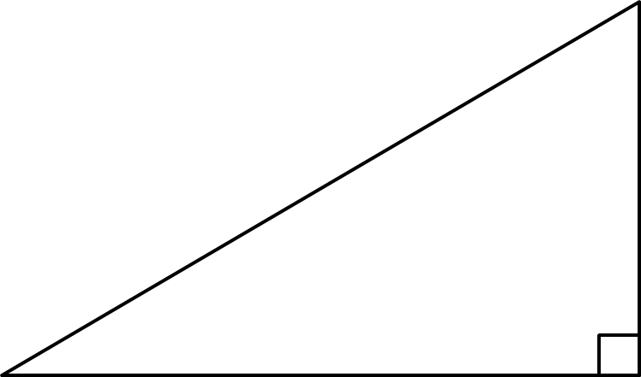
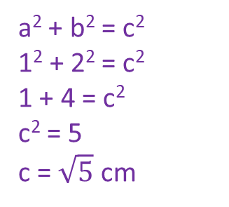
24
7
30
Topic: Right-Angled Triangles
Date
EQ – How can we work out the hypotenuse of right-angled triangles?
What is Pythagoras’ Theorem?
a² + b² = c²
c
a
b
How do we use it to find the hypotenuse?
Example:
c
1cm
2cm
a² + b² = c²
1² + 2² = c²
1 + 4 = c²
c² = 5
c = $\sqrt{5}$ cm
Step 1: Write the equation
Step 2: Rewrite it using the values we know
Step 3: Solve for the unknown
If we need the exact value we can leave the answer in surd form (leaving the square root sign).
Otherwise, calculate to 2 decimal places.

Slide 4


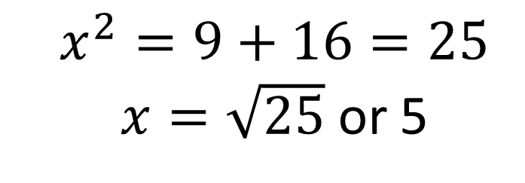
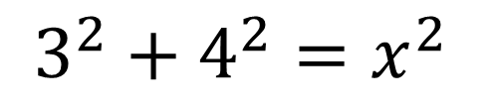

Let’s Try this Together
Step 1: To work out the hypotenuse.
Reveal >
$$x$$
$$3$$
Step 2: Form an equation
?
$$3^{2}+4^{2}=x^{2}$$
The hypotenuse appears on its own.
$$4$$
Step 3: Solve the equation to find the unknown side.
$$x^{2}=9+16=25$$ $x=\sqrt{25}$ or 5
?

Slide 5


Slide 6
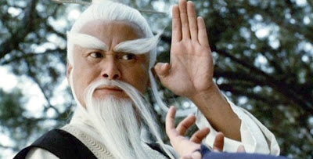







Test Your Understanding
2
?
Answer: $x=10$
42
1
?
Answer: $x=\sqrt{2}$
$$x$$
3
$$x$$
6
1
1
55
$$x$$
8
?
Answer: $x=\sqrt{4789}$
“To learn secret way of a maths ninja, find $x$ you must.”

Slide 7
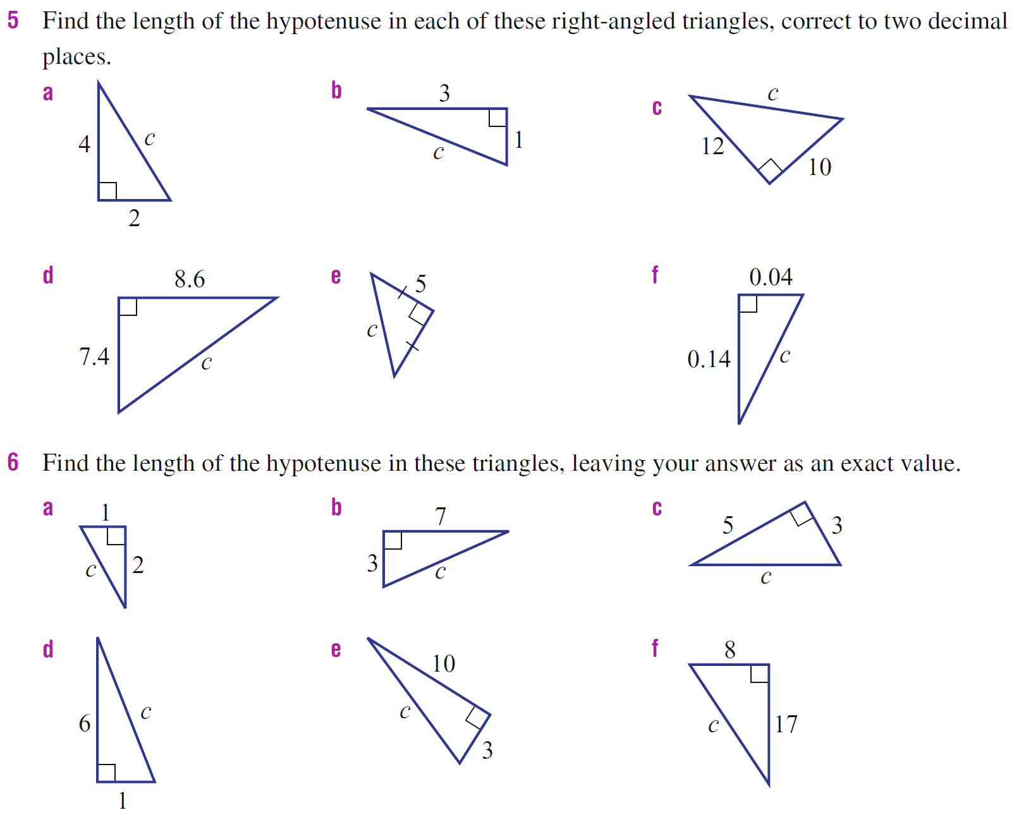
Practice

Slide 8
24
7
30
Topic: Right-Angled Triangles
Date
EQ – How can we work out the hypotenuse of right-angled triangles?
Summary
The longest side of a right-angled triangle is called _________________.
To work it out when we know the two shorter sides we use __________________ which is written as ______ + ________ = __________.

